Slide 1
Project #1 Kiosk Scrolling Message Board
Spring 2025
0512-4494
AIMAN ABED
EDWARD KHOURY

Slide 2

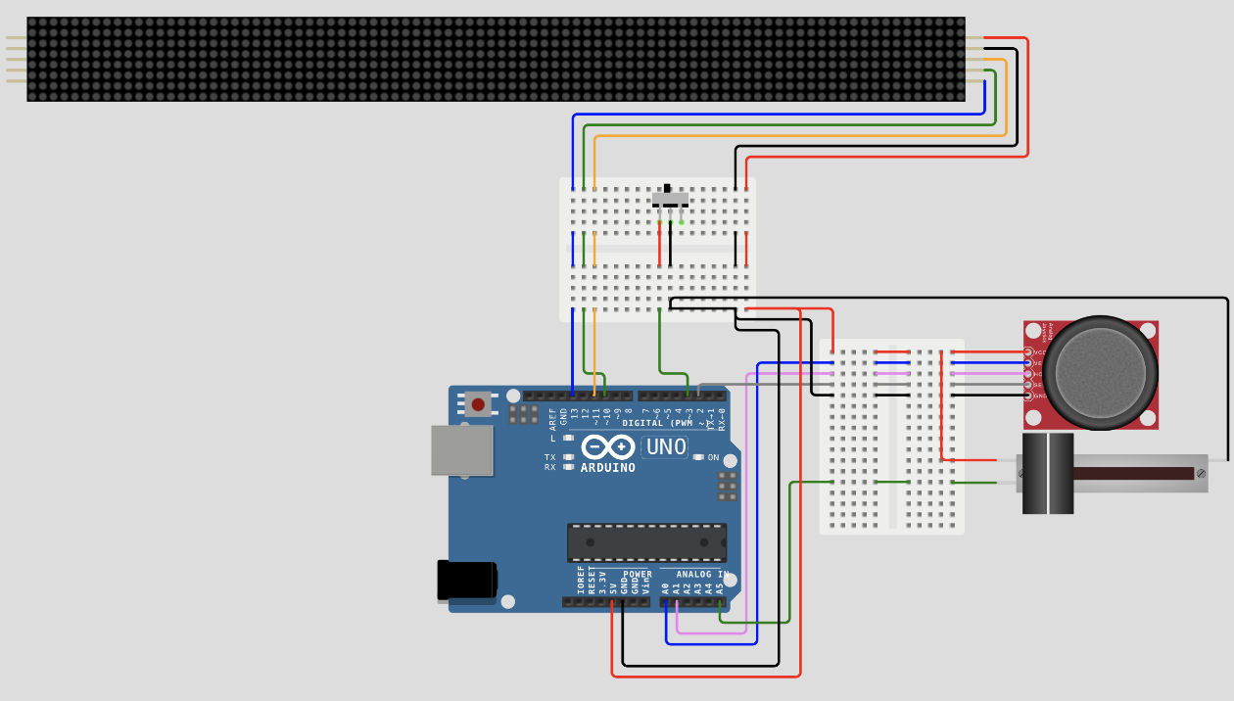
Hardware (Components) Diagram
ID | Type | Additional Attributes
uno | wokwi-arduino-uno | —
bb | wokwi-breadboard-mini | —
m1 | wokwi-max7219-matrix | Chain length: 11
joystick1 | wokwi-analog-joystick | Rotated 90°
pot1 | wokwi-slide-potentiometer | Travel Length: 30
sw1 | wokwi-slide-switch | Left is off / right is on

Slide 3

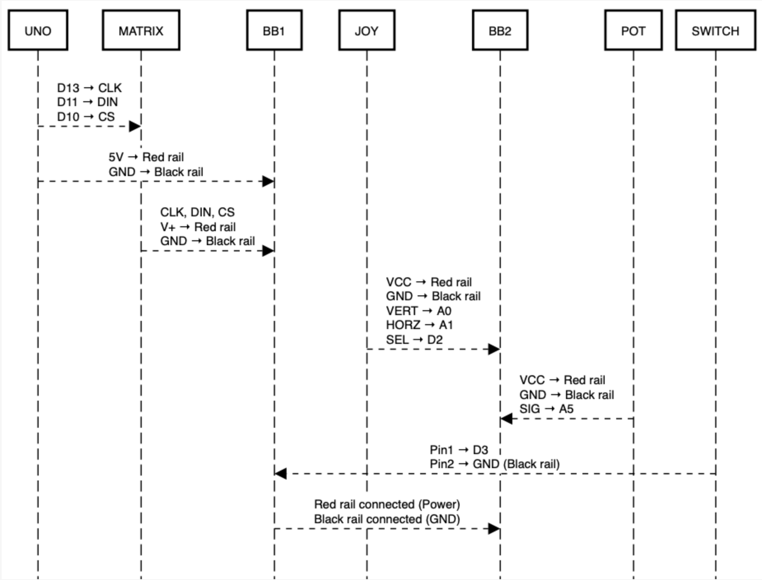
hardware Blocks Diagram
ARDUINO
Serial input handler
Message handler
Text buffer
MD_PAROLA Display Controller
Slide switch
Potentiometer
Joystick
Scroll direction, speed and display

Slide 4
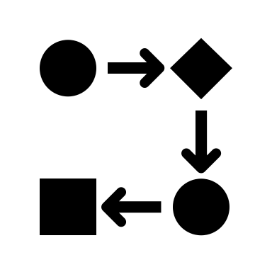
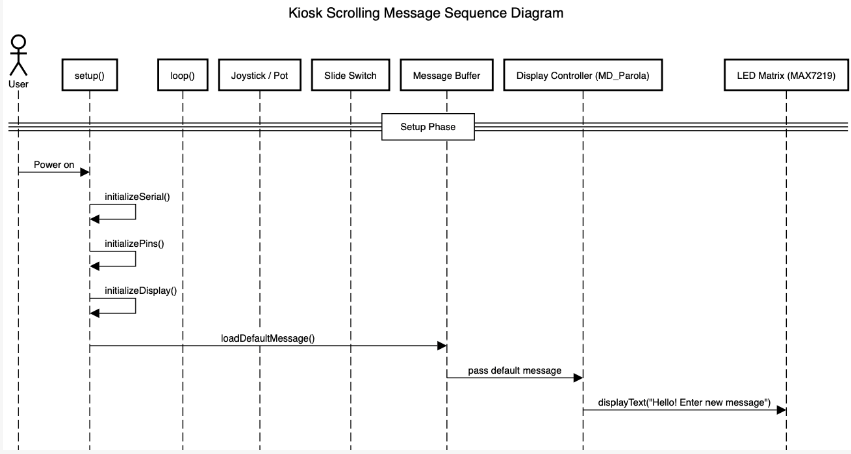
Sequences Diagram

Slide 5
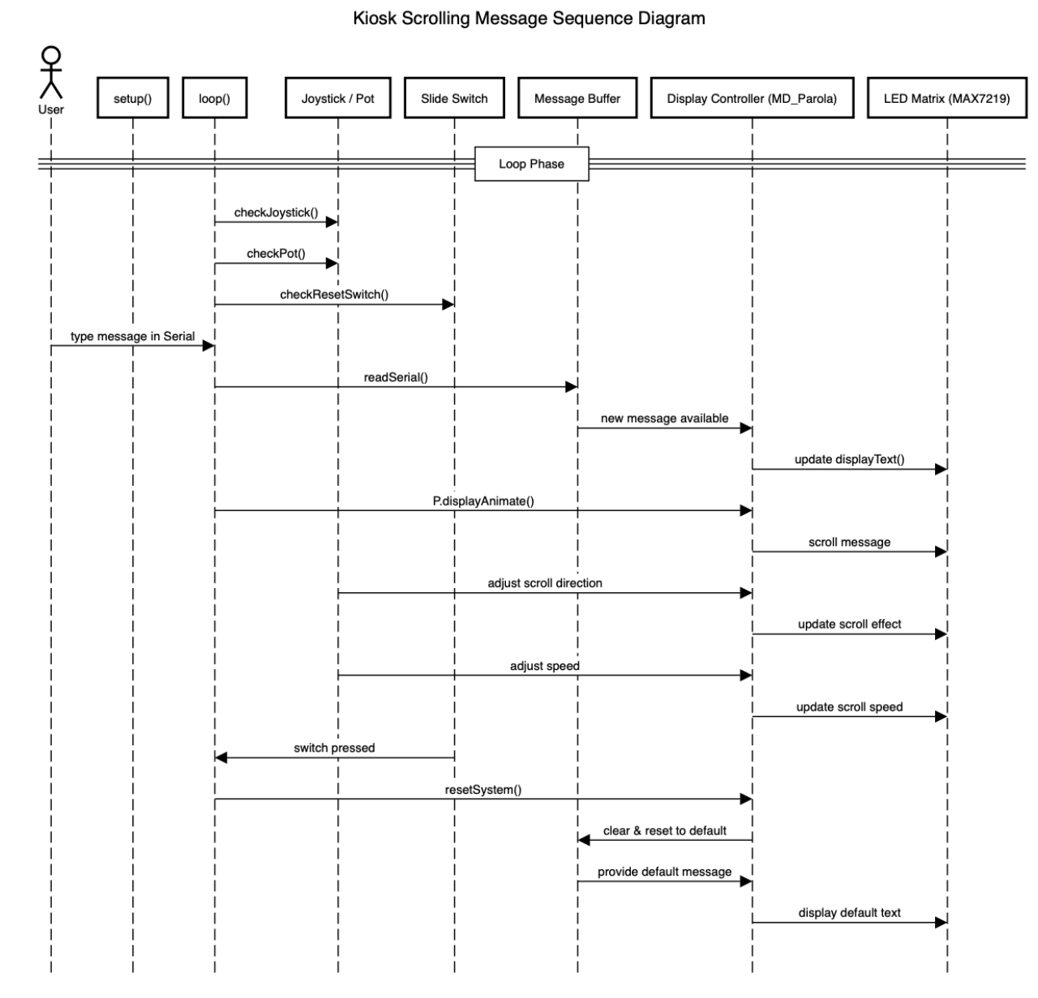

Slide 6

Live Demo
https://wokwi.com/projects/426850658354700289

Slide 7

Conclusions / Future Work
New insights that we got from this project
How to connect and program an LED matrix using the Parola library.
How to use a joystick, potentiometer, and slide switch as inputs.
How to organize Arduino code using functions and states.
How to draw sequence and state diagrams to explain how the system works.
Challenges
Making the joystick input work smoothly without glitches.
Making sure the display updates correctly when changing direction or message.
Ideas for Improvement
Add a small buzzer or LED for input feedback.
Off switch that shuts down the entire system while also retaining memory of the last state.
Save the last message using EEPROM.
Adding keyboard input for Easy user experience and better modularity.

